Slide 1
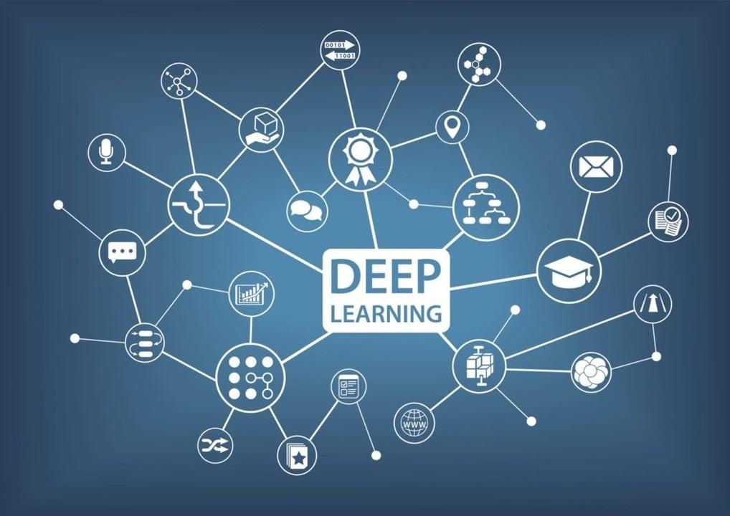

PROJECT
SIGN LANGUAGE
INTERPRETER

Slide 2
CONTENTS
PART 1
INTRODUCTION
PART 2
OBJECTIVES
PART 3
PROBLEM STATEMENT
PART 4
TOOLS AND TECHNOLOGIES
PART 5
FLOWCHART
PART 6
METHODOLOGY
PART 7
DESIGN

Slide 3
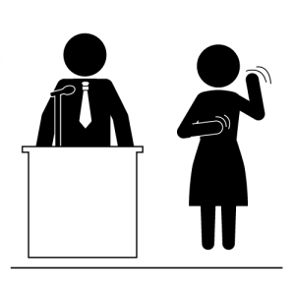
INTRODUCTION
Sign language is an important part of life for deaf and mute people. They rely on it for everyday communication with their peers.
There are over 300 sign languages used around the world, and 700 million deaf people using them.
The people who know sign language can communicate with each other efficiently. However, when it comes to communicating with people who don’t understand sign language it causes a lot of problems.
Deaf and mute people usually depend on sign language interpreters for communication. However, finding a good interpreter is difficult and often expensive.

Slide 4
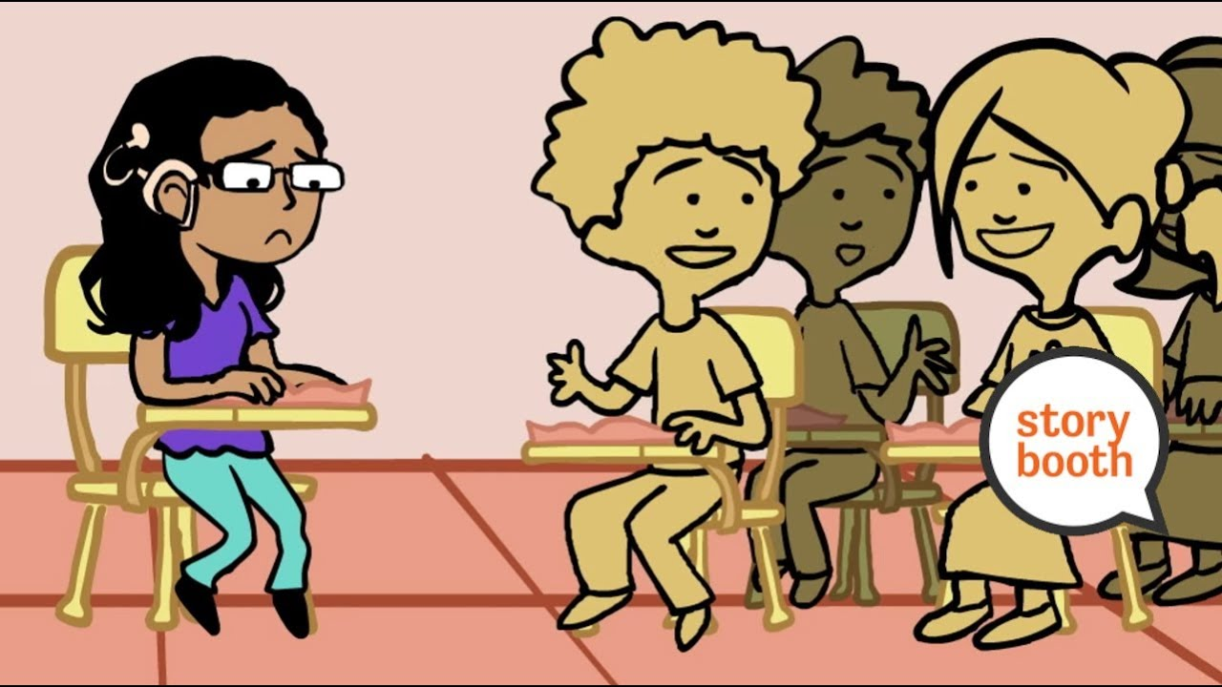
PROBLEM STATEMENT
To find a creative solution to benefit the lives of those with hearing and speaking disability by using technology in order to help them in communicating with others without any barriers.

Slide 5
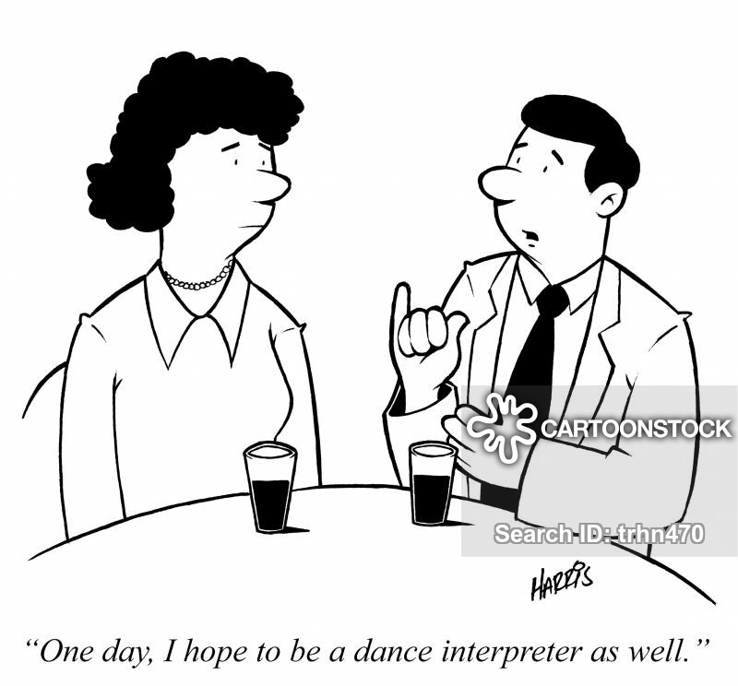
OBJECTIVES
Our Objective is to design a solution that is intuitive and simple which simplifies the communication for the majority of people with deaf and dumb.
Thus, a computerized interpreter could be a reliable and cheaper alternative so that communication gap between a normal and hearing impaired person can be easily bridged.
The aim of this project is to identify the symbolic expressions through image captured by the webcam of the computer and convert it into plain text that can help in real time communication.

Slide 6




TOOLS AND TECHNOLOGY
PYTHON
TENSOR FLOW
KERAS
OPEN CV

Slide 7
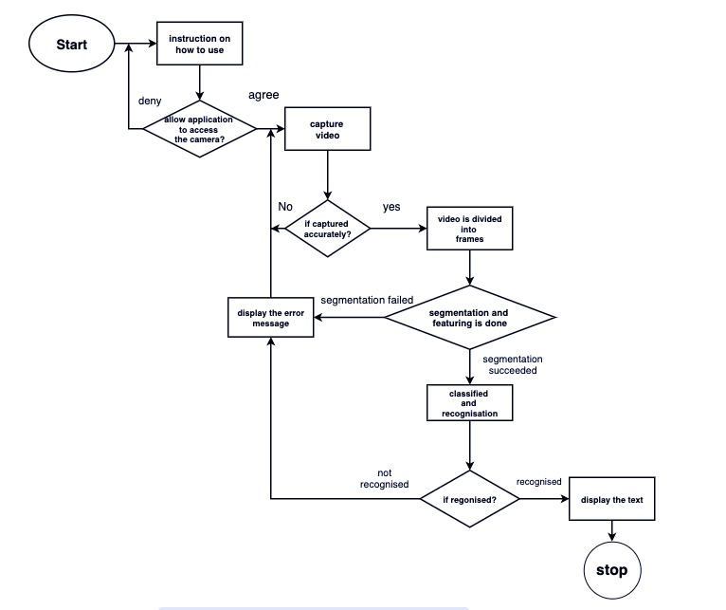
FLOWCHART

Slide 8
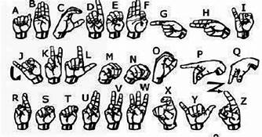
METHODOLOY
DATA CREATION
DATA PREPARATION
DEEP LEARNING

Slide 9
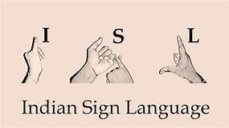
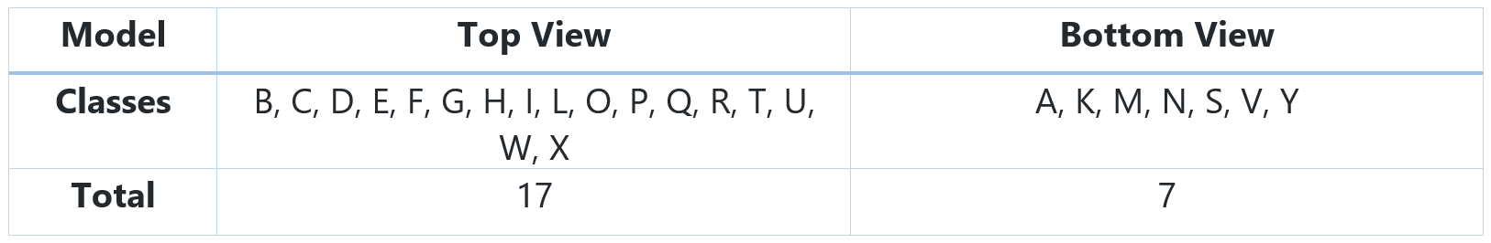
CREATING SAMPLE DATASET
Database of sign images consists of various images with image clicked in different light condition with different hand orientation. With such a divergent data set, we are able to train our system to good level and thus obtain good results.
the dataset was divided into two parts, one for each model as shown in the following table.

Slide 10
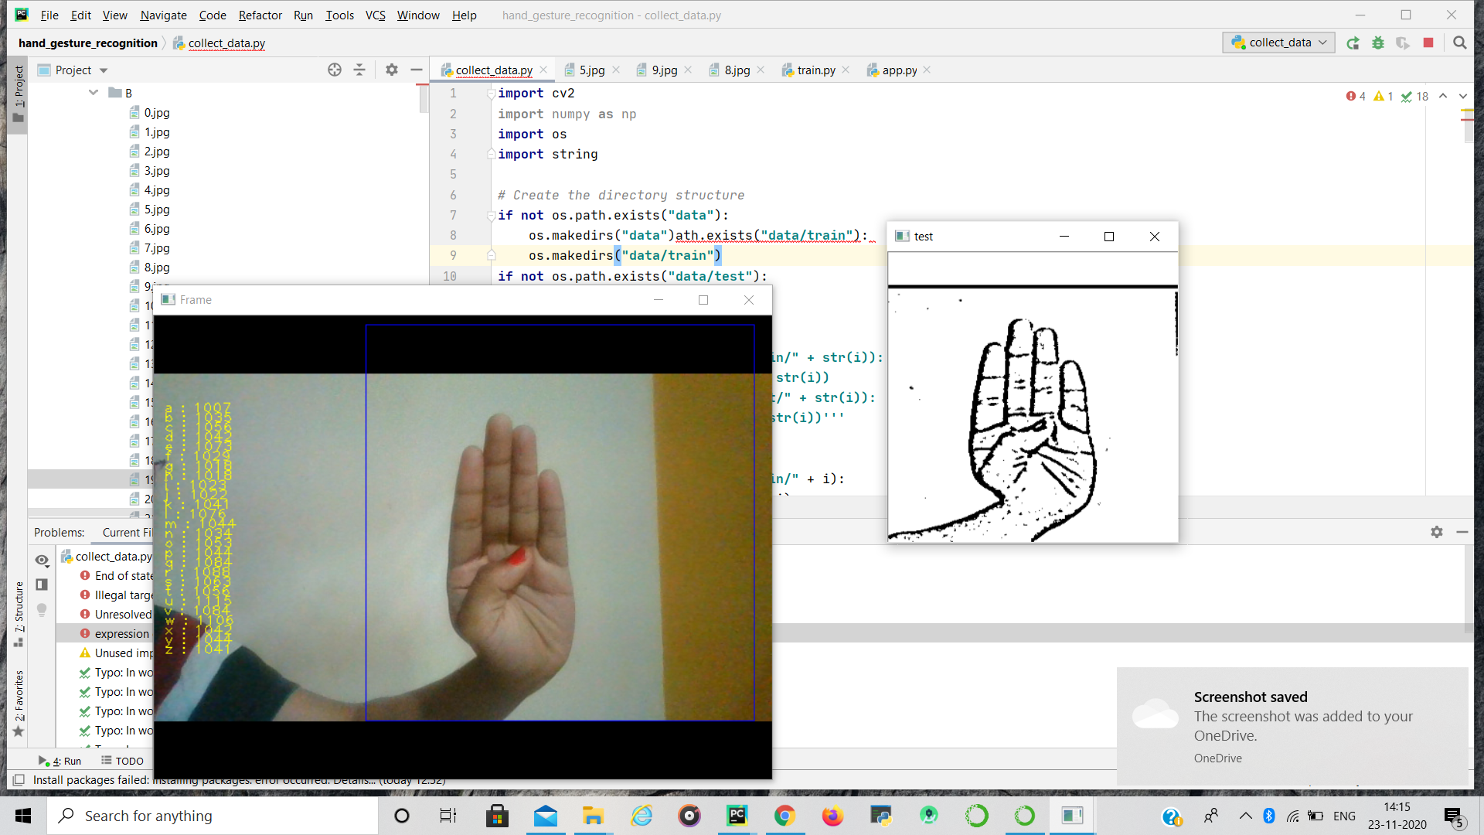

Slide 11
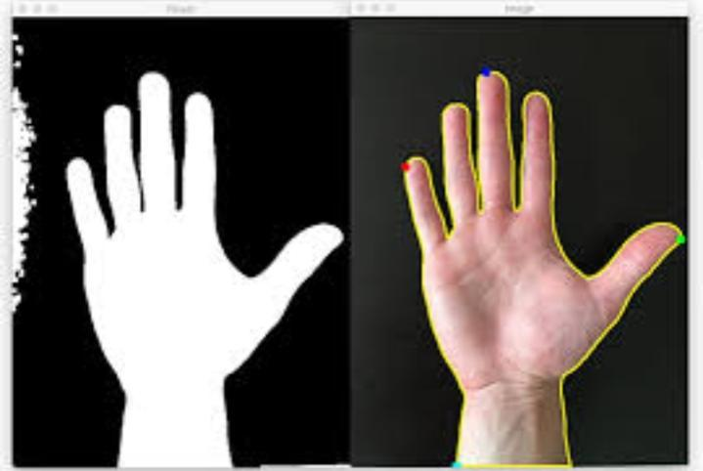
IMAGE PREPROCESSING
Segmentation:
The main objective of the segmentation phase is to remove the background and noises, leaving only the Region of Interest(ROI), which is the only useful information in the image.
This is achieved via Skin Masking defining the Threshold on RGB schema and then converting RGB colour space to grey scale image .
Finally Canny Edge technique is employed to identify and detect the presence of sharp discontinuities in an image, thereby detecting the edges of the figure in focus.

Slide 12
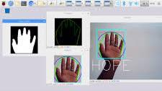
FEATURE EXTRACTION:
The Speeded Up Robust Feature(SURF) technique is used to extract descriptors from the segmented hand gesture images.
SURF is a novel feature extraction method which is robust against rotation, scaling, occlusion and variation in viewpoint.

Slide 13
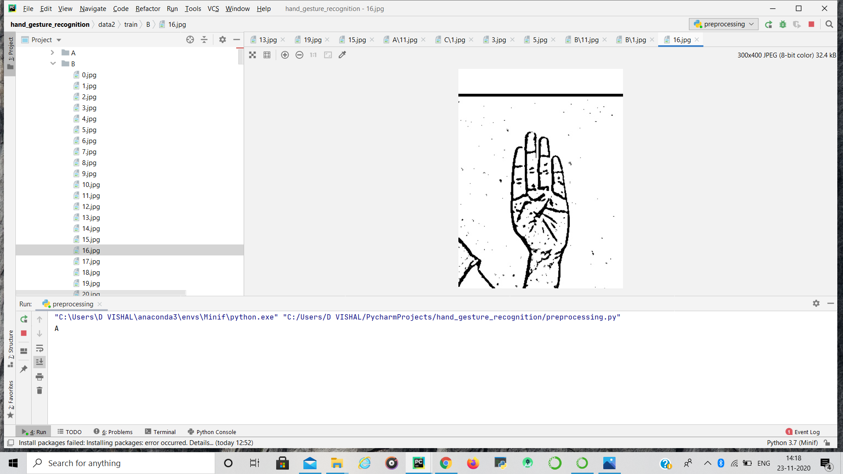

Slide 14
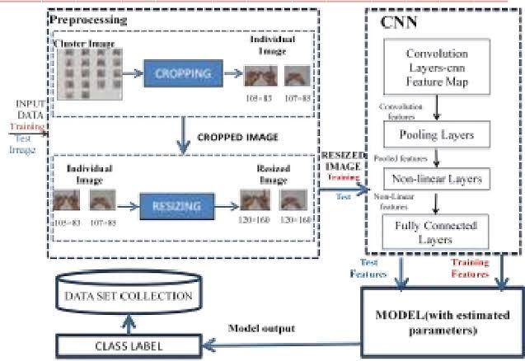
CLASSIFICATION
The SURF descriptors extracted from each image are different in number with the same dimension (64). However, a multiclass SVM requires uniform dimensions of feature vector as its input.
Bag of Features (BoF) is therefore implemented to represent the features in histogram of visual vocabulary rather than the features as proposed. The descriptors extracted are first quantized into 150 clusters using K-means clustering.
The clustered features then form the visual vocabulary where each feature corresponds to an individual sign language gesture.
With the visual vocabulary, each image is represented by the frequency of occurrence of all clustered features. BoF represents each image as a histogram of features, in this case the histogram of 24 classes of sign languages gestures.

Slide 15
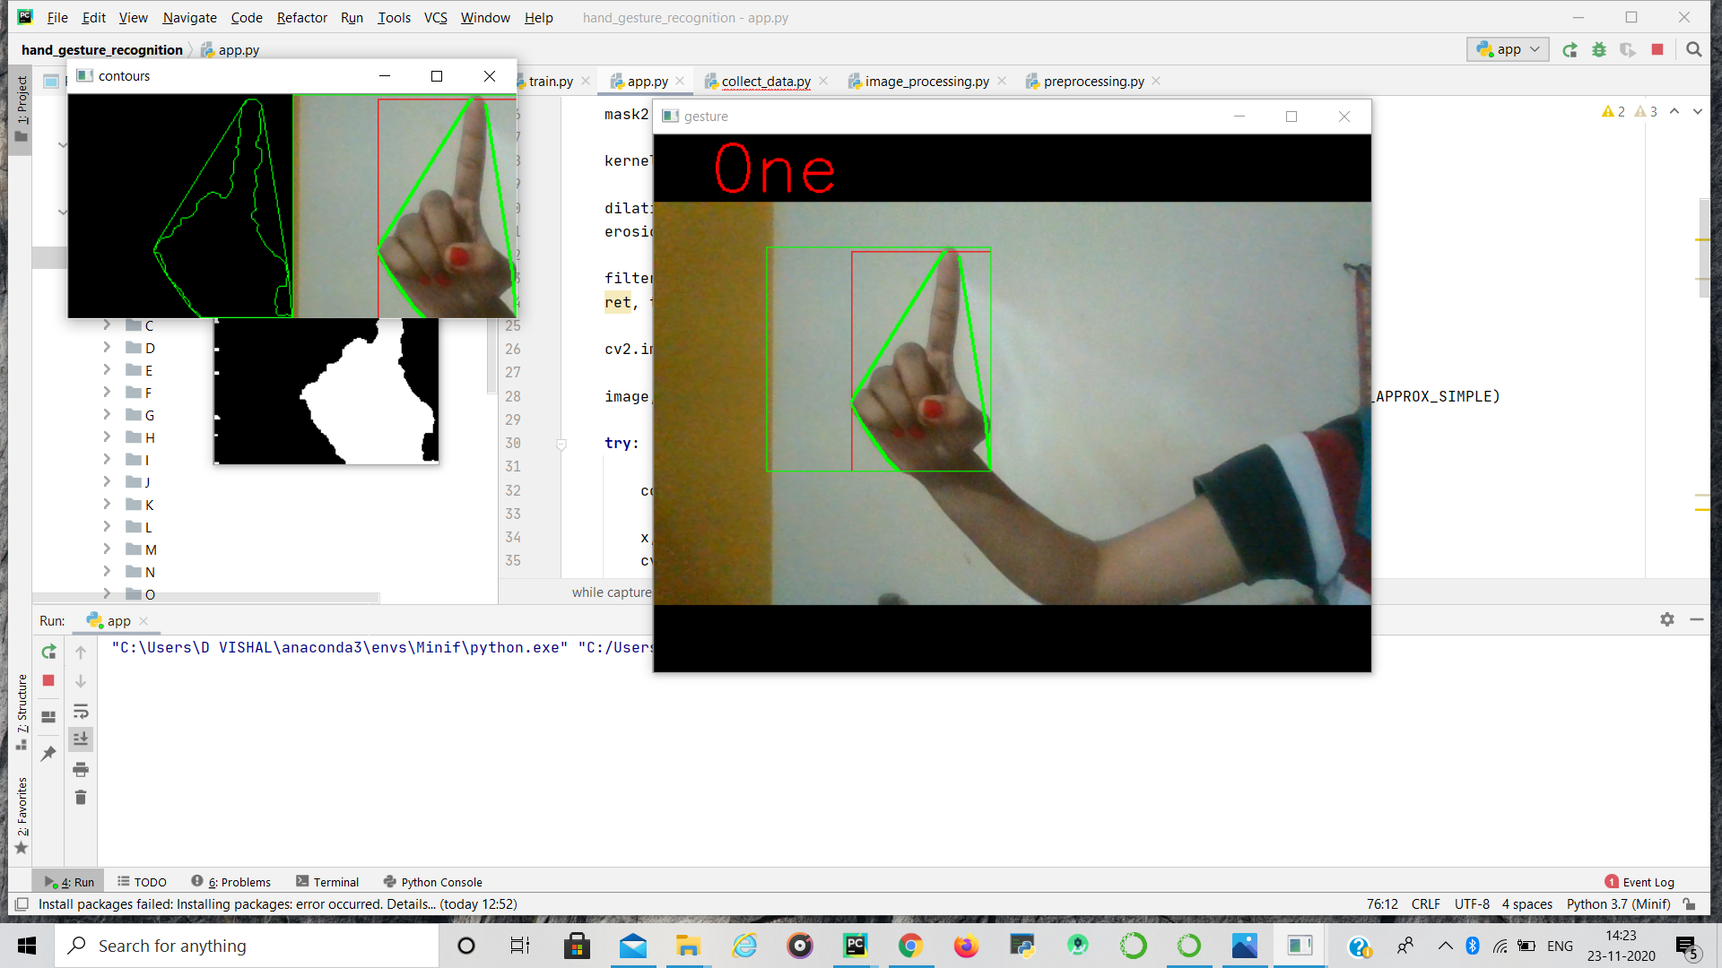
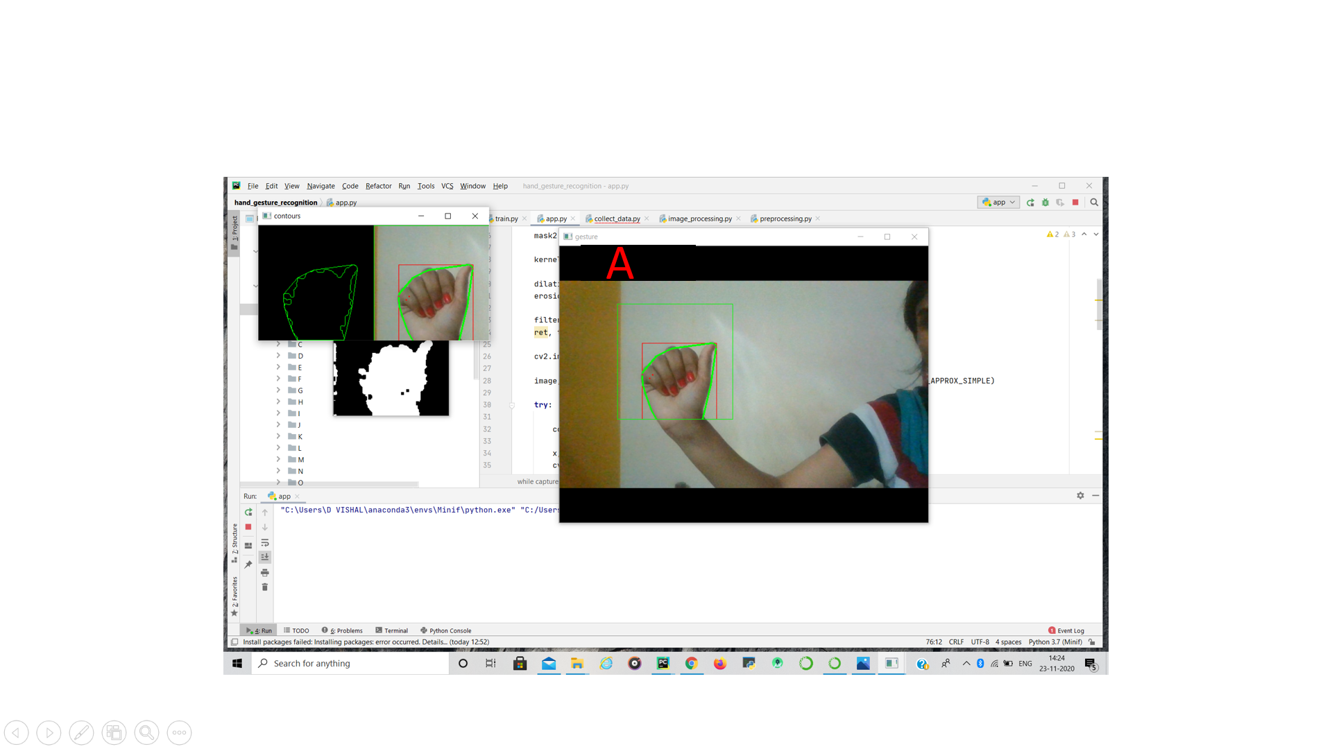

Slide 16
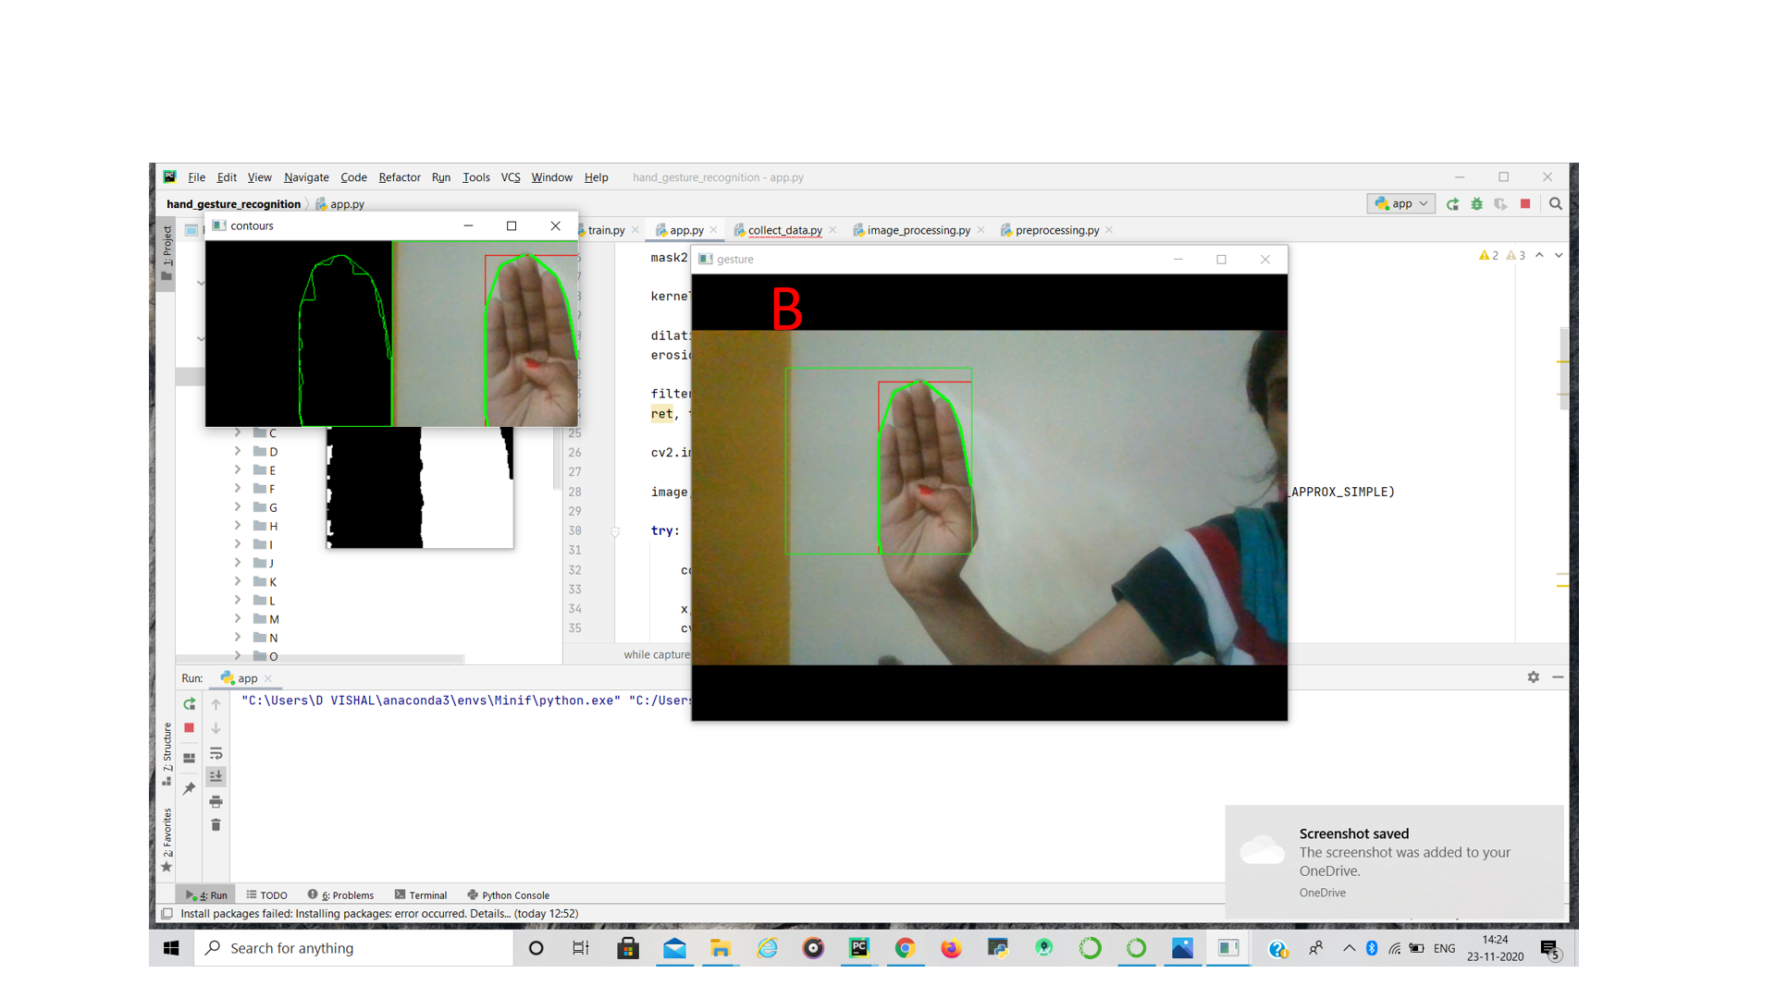
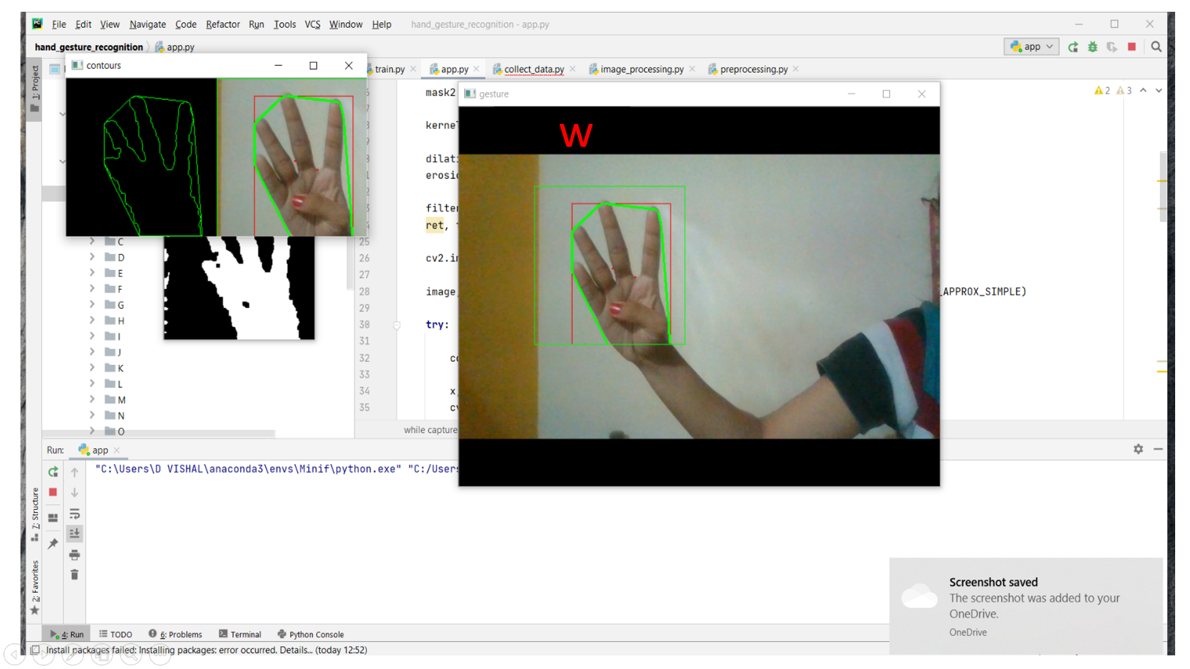

Slide 17
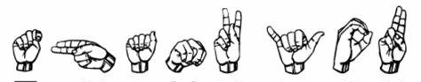
THANK YOU

